Slide 1

AVIATION BUSINESS EXPANSION

Slide 2
PRESENTATION BY ERICK JOHN KIBUGI
Erick.kibugi@student.moringschool.com

Slide 3
introduction
Business Problem:
The company wishes to expand its portfolio into the aviation industry by purchasing and operating airplanes for commercial and private enterprises.

Slide 4

A little information about airplanes
The story of humans flying started as far back as the Greek myth of Deadalus and his son Icarus. Probably where we learned “If you fly too close to the sun you will get burned.”
The fisrt humans to actually fly were the Wright Brothers (Wilbur and Orville) in 1903 .
The fastest ever commercial aircraft was the Concorde that operated 1976-2003 (27 years). It could fly across the Atlantic in 3.5 hours at a speed of Mach 2; twice the speed of sound

Slide 5
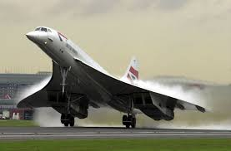
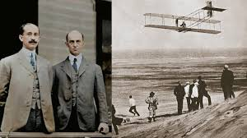
Wright brothers
THE CONCORDE

Slide 6
Data findings
As with any industry, accidents and incidents that lead to damage seem to be common.
Filtered data shows 6971 accidents and 117 incidents.
Majority of events are in regards to Aeroplanes followed by Helicopters

Slide 7
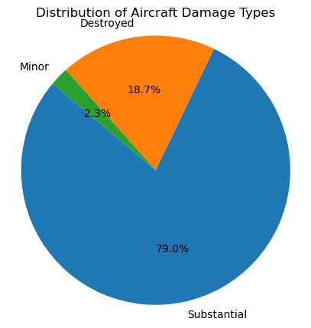
To ensure good quality aircrafts that have not gone through a lot of wear and tear, it would be best to get those with minor damage.
This helps reduce any future probability of high maintenance and repair costs.

Slide 8
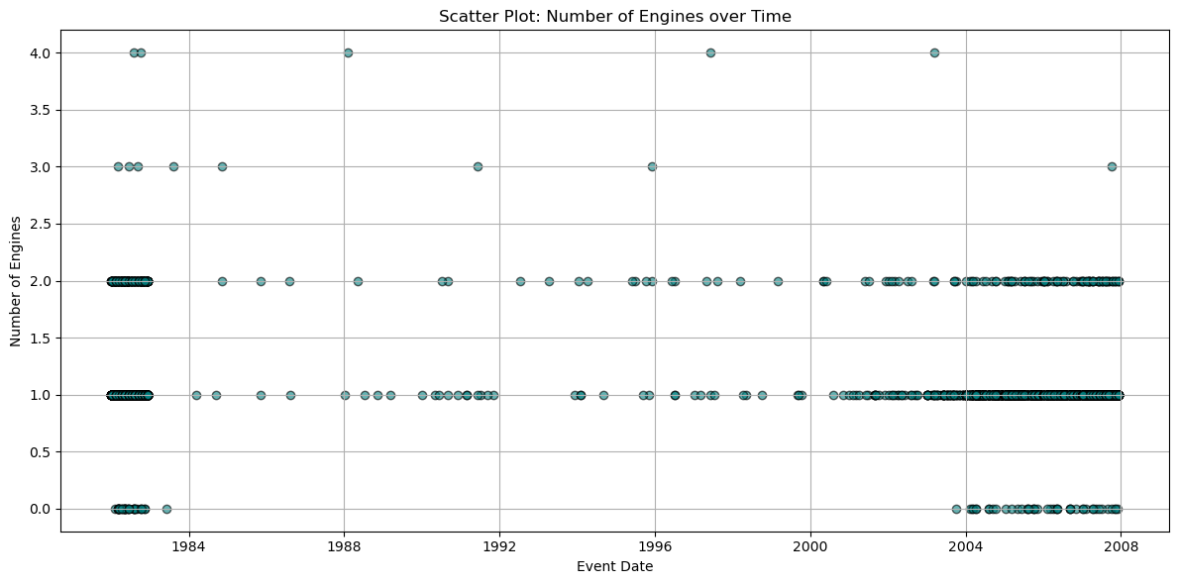
As the years go by, more planes are being manufactures and those with fewer engines tend to have more accidents compared to those with more than 2.

Slide 9
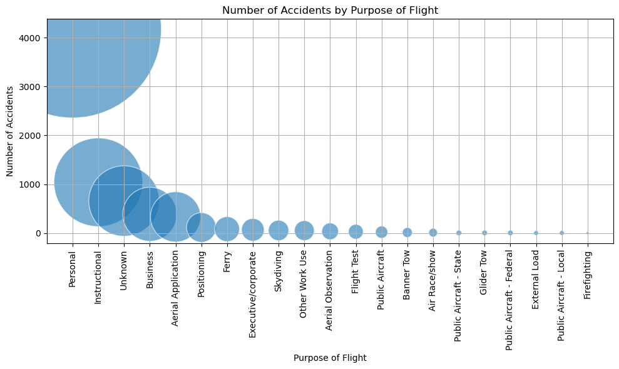
The chart above shows that more aircrafts used for personal use tend to get into accidents compared to those used by professional organizations like figherfighters.

Slide 10

—Leonardo da Vinci
“Once you have tasted flight, you will forever walk the earth with your eyes turned skyward.”

Slide 11
5,536 km
$90,000-$120,000
$10,000-$15,000
FLIGHT OPERATION BOEING 747 LONDON (HEATHROW) – NEW YORK (JFK)
Distance
Fuel
Crew Salaries
Landing & airport fees
$10,000-$25,000
Maintenance fees
$10,000-$25,000
Navigation & ATC fees
$2,000-$5,000
Catering & in-flight service
$8,000-$15,000
ETC
$42,000
TOTAL
$172,000-$247,000

Slide 12
INDUSTRY SPECIFIC RISKS
02
04
01
03
Regulatory & environment compliance
Strengthen IT infrastructure and real-time solutions
Geopolitical instability
Use fuel hedging contracts to lock in prices and reduce exposure
Diversify routes and insure against political risks
Fuel price volatility
CYBERSECURITY
Invest in greener fleets and monitor internatinal aviation regulations

Slide 13
rECOMmENDATIONS
Damage
Minor damage is highly recommended
Build
Professional build is highly recommended
Sourcing
From US companies like Boeing and Gulfstream
Purpose
Commercial, Executive/Corporate

Slide 14
THANKS!
DO YOU HAVE ANY QUESTIONS?
Erick.kibugi@student.moringaschool.com

